Slide 1
The Strongest Cricket Team (1996- 2005)
By: Dillirajan Sankar

Slide 2
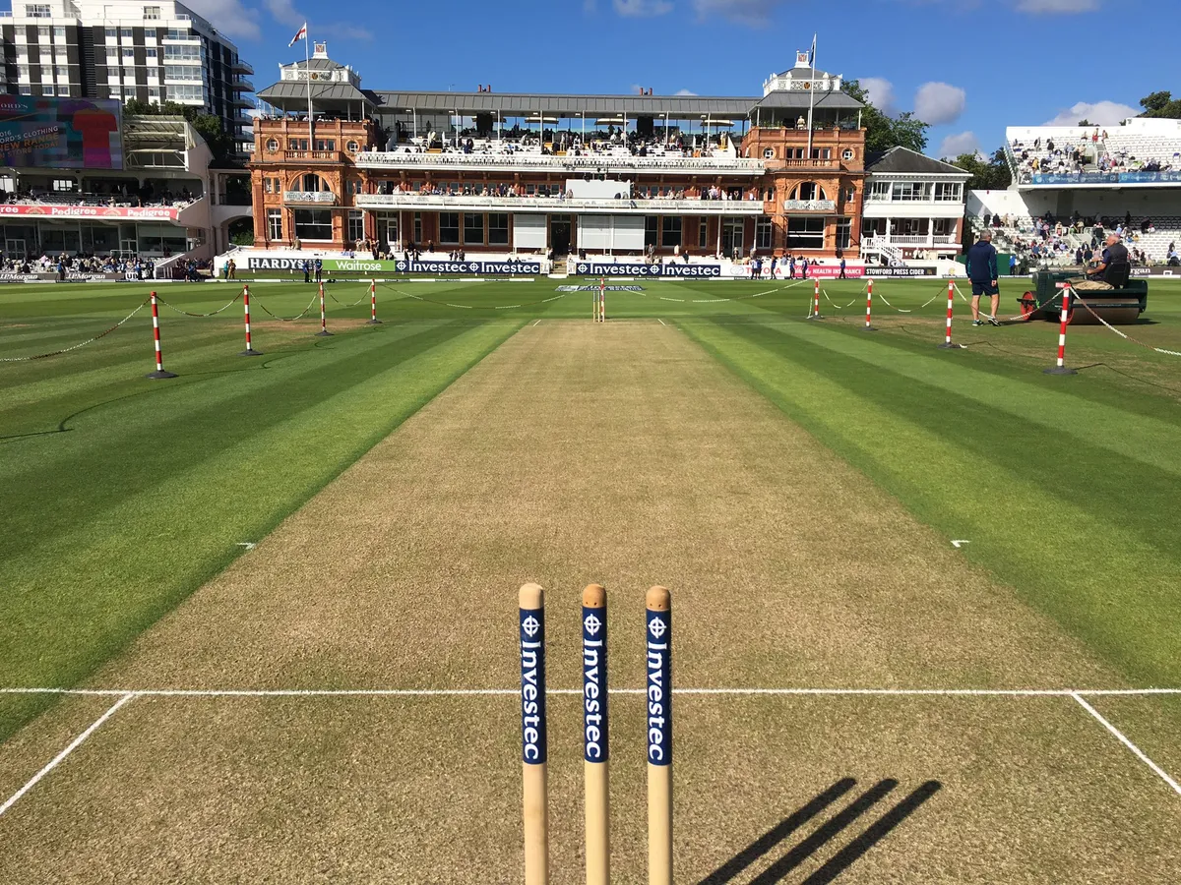
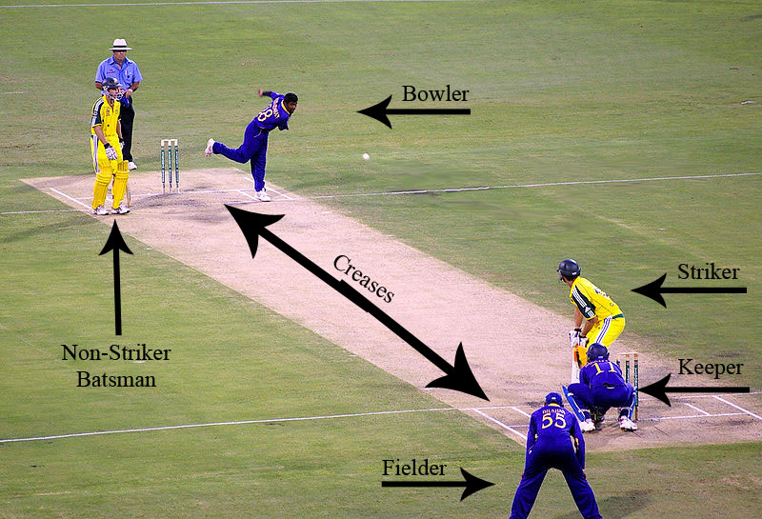
Brief Introduction to the Sport, Cricket
Wicket on which ball is bowled
Batters, Bowler, and Fielders

Slide 3
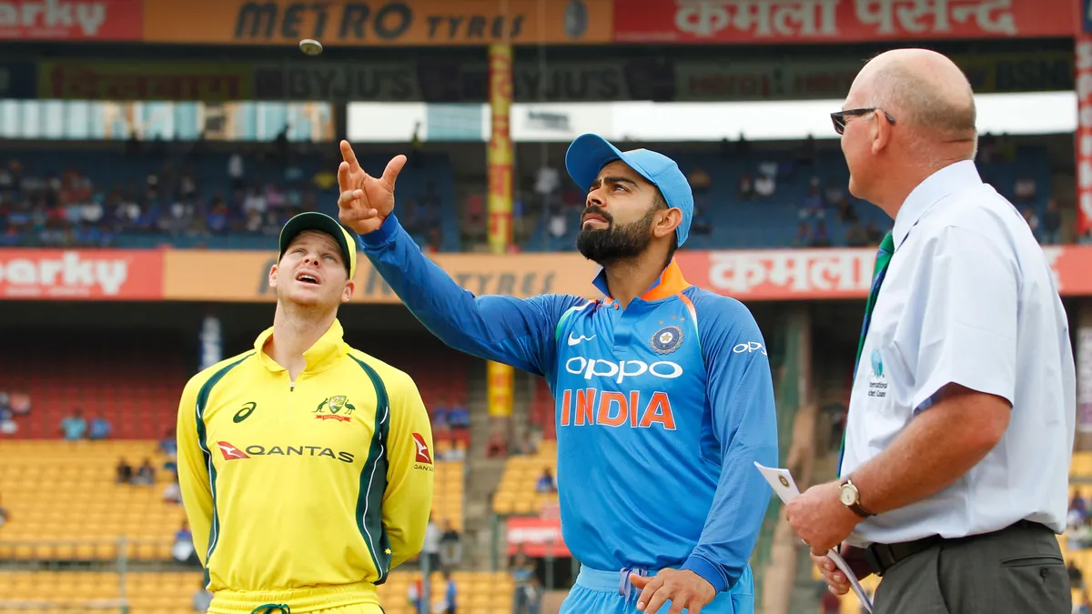
Toss to decide who bats/bowls first

Slide 4
Data Preparation
Dataset from Kaggle.com
Includes features (columns) like ‘Teams played in game’, ‘Runs scored by Team 1 and 2’, ‘Winner of the Game’, ‘Venue at which the game was played’, ‘Toss Winner’, ‘Toss Decision’, and ‘Game Date’.
Apart from these variables, I created calculated fields to determine the loser of the game and the loser of the toss.
I also created 2 more calculated fields to sort data in a specific storypoint.

Slide 5
Storypoints

Slide 6
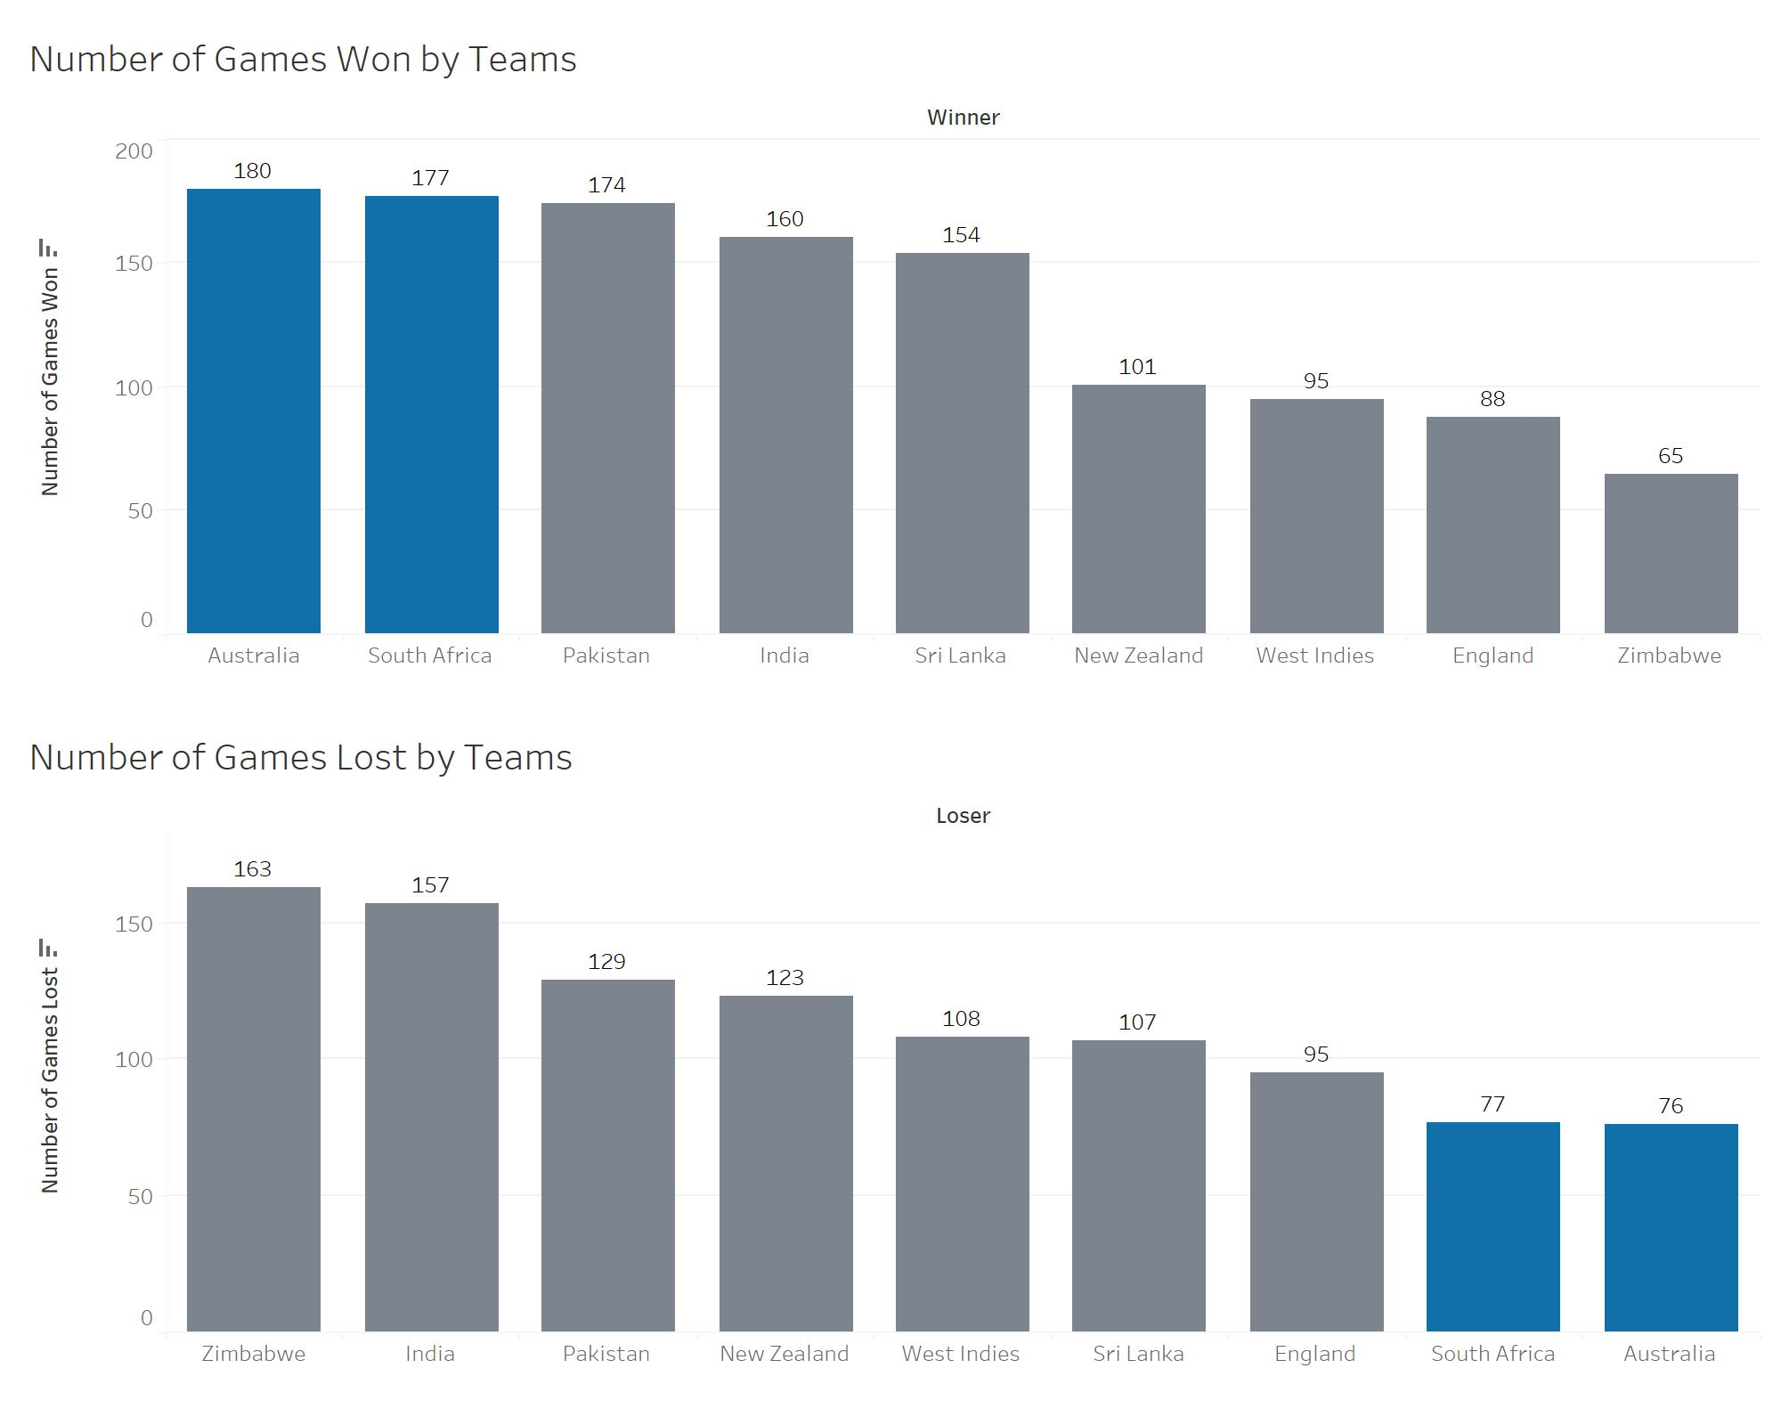
Number of Games Won and Lost By Teams
Australia and South Africa won more games and lost lesser games.

Slide 7
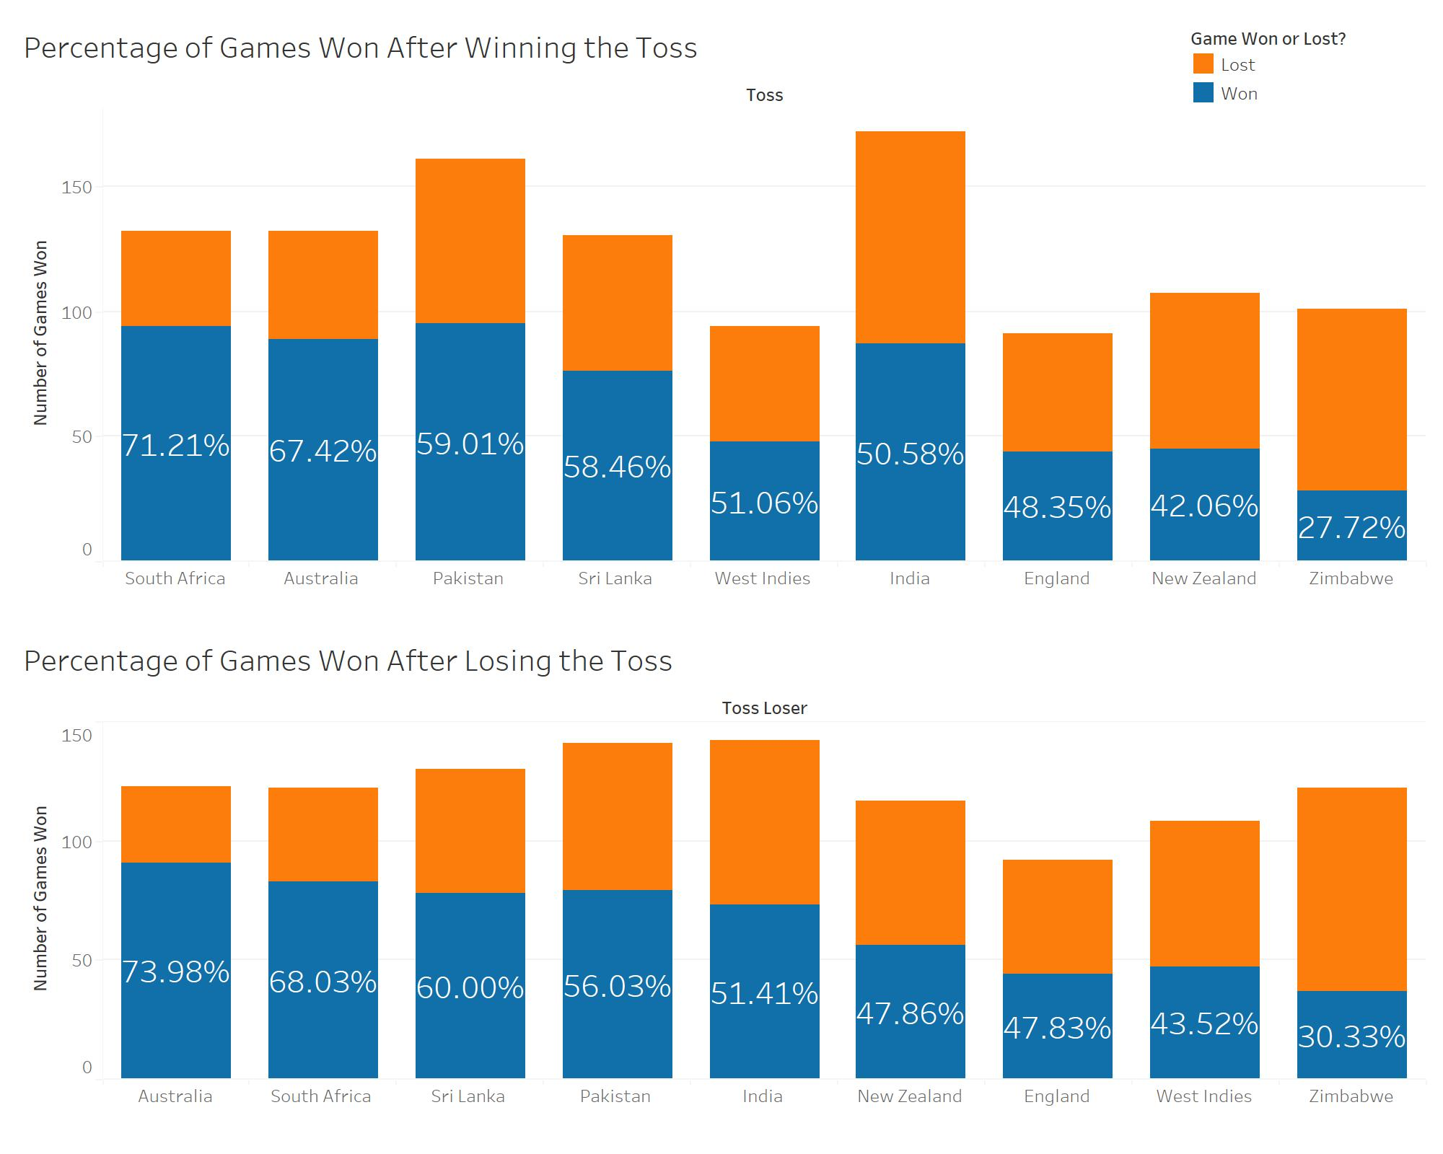
Percentage of Games won by teams after Toss Win/ Loss
Australia and South Africa have won a significant percentage of games irrespective of winning/ losing the toss.

Slide 8
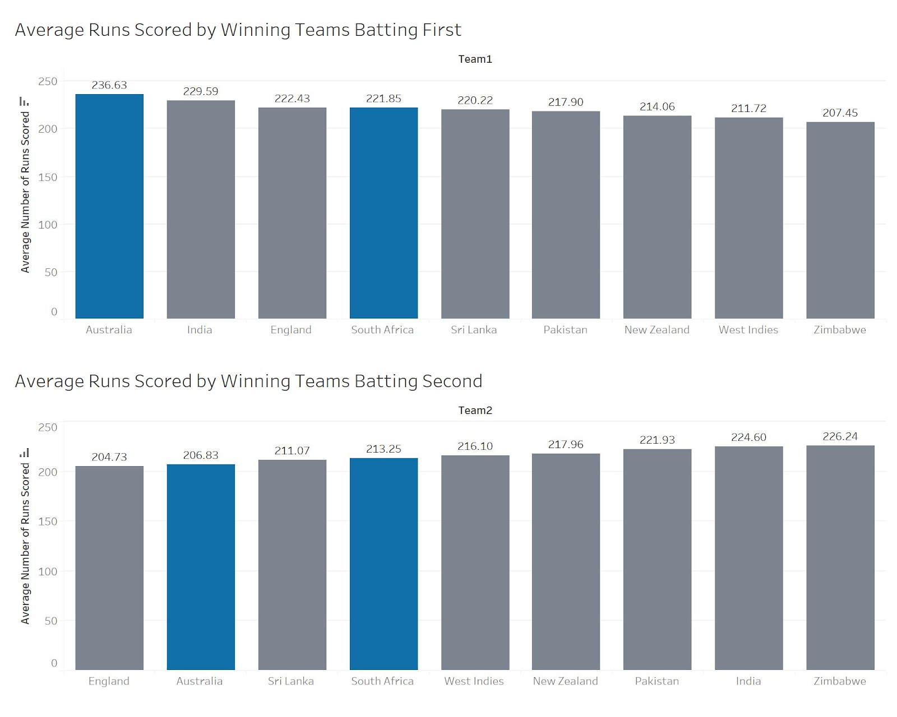
Average Runs Scored by Winning Teams- Batting 1st/ 2nd
Australia and South Africa have scored more runs when batting first than second which is sign of a strong team.

Slide 9
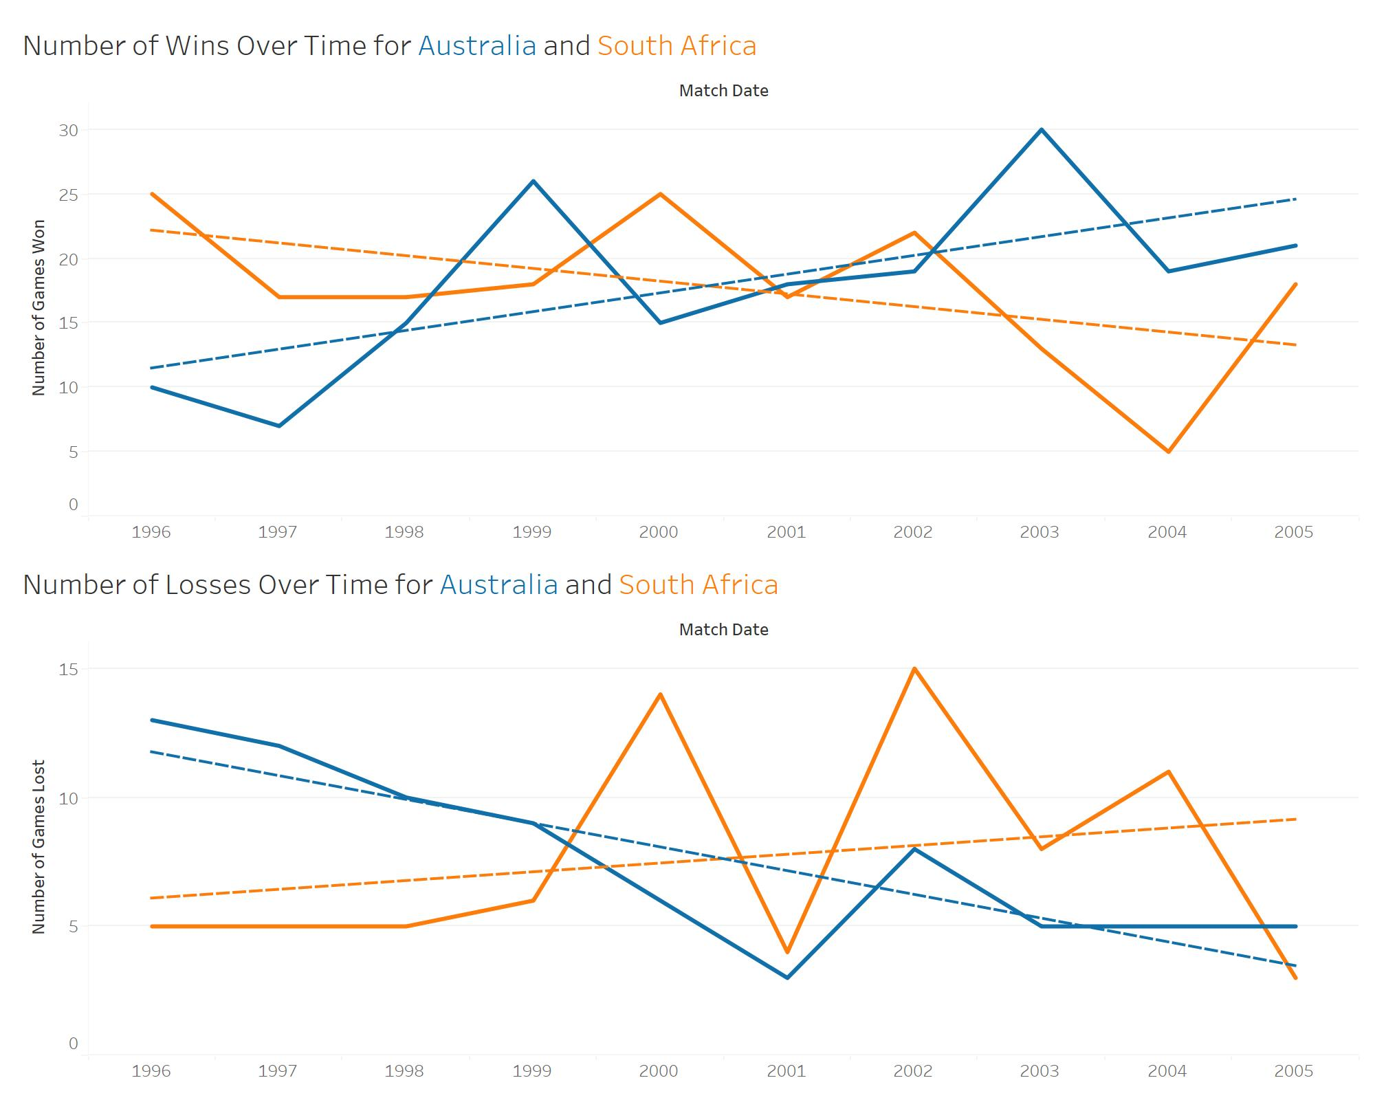
Wins and Losses Over Time for Australia and South Africa
Australia has improved its performance over time whereas South Africa has seen a drop in performance.

Slide 10
Conclusions
Australia and South Africa have won more games and lost lesser number of games in comparison to other teams.
Australia and South Africa won a significant percentage of their games irrespective of whether or not they won the toss. This is a sign they were strong teams.
Both Australia and South Africa scored more runs when batting first in comparison to batting second which is again a sign of a strong team.
Australia had improved its performance over time whereas South Africa saw a drop in its performance over the same period.
Thus, we can conclusively infer that Australia was the best all-round cricket team between 1996 and 2005.

